Slide 1
Important Note Regarding This Microsoft PowerPoint Presentation
* Do not include this slide in your presentation *
This slide deck has been intentionally provided with very limited graphics and formatting to simplify content integration into your own preferred PowerPoint themes and styles.

Slide 2
Security Development Lifecycle (SDL) Field Content
Buffer Overflows
(Level 300)

Slide 3
Agenda
Overview of the Microsoft SDL
Overview of buffer overflows
Stack-based
Heap-based
Buffer overflow myths
Reducing the risk of buffer overflow attacks in code with the Microsoft SDL

Slide 4

Microsoft Security Development Lifecycle (SDL)
Training
Requirem-ents
Design
Implemen-tation
Verification
Release
Response
Delivering secure software requires:
Executive commitment → SDL a mandatory policy at Microsoft since 2004
Education
Technology and Process
Accountability
Ongoing Process Improvements → 6 month cycle

Slide 5
Buffer Overflows Overview
Buffer Overflow: Occurs when data is written into a fixed-length buffer and the size of that data exceeds the capacity of the receiving buffer
Primary Risks: Corrupt data, crash programs and control execution flow
Common in native applications (C/C++)
Rare, but still possible in managed code (.NET, Java)
Cause is failing to validate input
Can occur on stacks and heaps

Slide 6
Buffer Overflow Illustration

Slide 7
Review of Application Stack Frames
void main(void)
{ FunctionOne(arguments);
FunctionTwo();
}
void FunctionTwo(void)
{ /* Operations */
}
void FunctionOne(int c)
{ int LocalInt;
char LocalBuffer[32];
/* Operations */
}
Local function variables
Saved Frame Pointer
Return Address
Function parameters

Slide 8
Stack-Based Buffer Overflows
Primary Risk: Ability to overwrite control structures
/* UNSAFE Function */
void UnsafeFunction(char * str)
{
char Buffer[32];
/* Copy str into Buffer */
strcpy(Buffer,str);
}
SAMPLE INPUTS (STR VALUES):
“Kevin”
“A” repeated 40 times
Buffer (32 Bytes)
AAAA
AAAA
Address of Buffer
Saved Frame Pointer
Return Address
Function parameters
Kevin
Malicious Payload or Machine Instructions
AAAAAAAAA … (32 times)… AAAAAAAAA

Slide 9
Review of Application Heaps
void SampleFunction(void)
{
/* Allocate space on heap */
char * ptr = (char *)malloc(32);
/* Operations */
/* Free allocated heap space */
free(ptr);
}
Pseudo-code For Chunk Freeing:
NextChunk = Current->FP
PreviousChunk = Current->BP
NextChunk->BP = PreviousChunk
PreviousChunk->FP = NextChunk
FP
BP
Data
FP
BP
Data
FP
BP
Data
Chunk #3
Chunk #2
Chunk #1

Slide 10
Heap-Based Buffer Overflows
Primary Risk: Ability to write arbitrary 4 byte DWORD anywhere in memory (return address, pointers, etc.)
/* UNSAFE Function */
void UnsafeFunction(char * str)
{
/* Allocate 32 bytes heap space */
char * Buffer = (char *)malloc(32);
/* Copy str into Buffer */
strcpy(Buffer,str);
}
Pseudo-code For Chunk Freeing:
NextChunk = Current->FP
PreviousChunk = Current->BP
NextChunk->BP = PreviousChunk
PreviousChunk->FP = NextChunk
AAAA
AAAA
AAAA
AAAA
AAAA
AAAA
FP
BP
Data
FP
BP
Data
FP
BP
Data
AA(32 times)AA
Chunk #3
Chunk #2
Chunk #1

Slide 11
Buffer Overflow Demonstration

Slide 12
Common Buffer Overflow Myths
Myth #1: Buffer overflows only affect Microsoft platforms
Myth #2: Buffer overflows cannot exist in managed languages (e.g., NET and Java)
Myth #3: Buffer overflows cannot be exploited on application heaps

Slide 13
Reducing Exposure to Buffer Overflows with the Microsoft SDL
Reducing Risk From Buffer Overflows
Reduce Attack Surface and Least Privilege
Search for risky functions and determine data origin
Use safer libraries and classes (StrSafe, Safe CRT, STL)
/GS, NX and Heap Checking
PREFast & SAL
Fuzz Testing
Presentation content is available for all of these topics

Slide 14
Microsoft SDL: Use Attack Surface Reduction and Least Privilege Principles
Attack Surface Reduction: Reduces the number of exploitable buffer overflow vectors
Least Privilege: Reduces the potential damage from exploited buffer overflows
See Presentation:
Secure Design Principles (Level 100)

Slide 15
Microsoft SDL: Review Source Code for Buffer Overflows
Source code review: Manual inspection of application for specific vulnerabilities, such as buffer overflows
See Presentation:
Secure Code Review – Buffer Overflows (Level 200)

Slide 16
Microsoft SDL: Use Safer APIs and Avoid Banned APIs
Safer APIs: Development libraries that are more resistant to buffer overflows
Banned APIs: Development libraries that can easily lead to buffer overflows, and banned for use by the Microsoft SDL
See Presentation:
Banned APIs (Level 200)

Slide 17
Microsoft SDL: Use Run-Time Protection
Compiler Protection: Run-time checks that reduce risk from buffer overflow attacks
See Presentation:
Compiler Protection (Level 200)

Slide 18
Microsoft SDL: Use Code Analysis Tools
Code Analysis Tools: Automated tools designed to aid in the identification of known vulnerabilities in code
See Presentations:
Code Analysis (Level 200)
Source Code Annotation Language (Level 200)

Slide 19
Microsoft SDL: Use Fuzz Testing
Fuzz Testing: A testing methodology that can help identify security issues that manifest in applications due to improper input validation
See Presentations:
Secure Verification Principles (Level 100)
Fuzz Testing (Level 300)

Slide 20
Platform Protection From Buffer Overflows
Modern day operating systems and processors have built-in buffer overflow protection
Address Space Layout Randomization (ASLR)
Data Execution Protection (DEP)
However none of these are “silver bullets”
Developers still need to follow security best practices
Developers should always apply the Microsoft SDL

Slide 21
Conclusion
Overview of Microsoft SDL
Overview of buffer overflows
Buffer overflow myths
Reducing the risk of buffer overflow attacks in code with the Microsoft SDL

Slide 22
Appendix

Slide 23


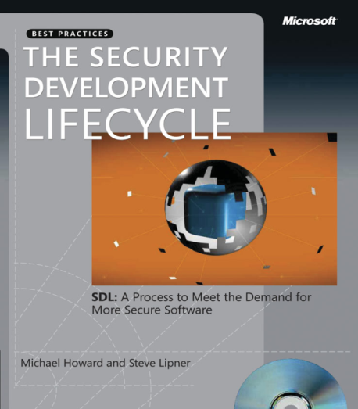


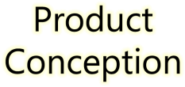
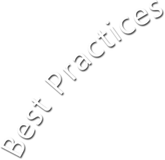














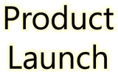





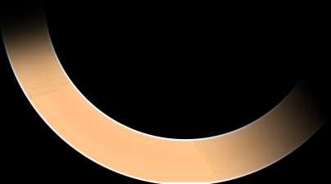

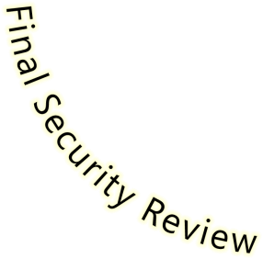


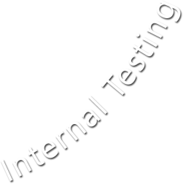





Microsoft Security Development Lifecycle (SDL)
SDL Book:
http://www.microsoft.com/mspress/books/8753.aspx
Official SDL Web Site: http://www.microsoft.com/sdl

Slide 24
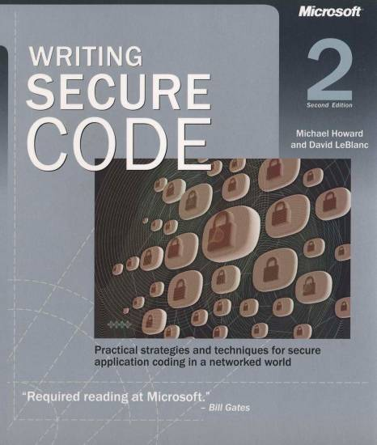
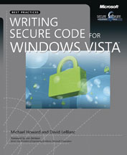
Microsoft Writing Secure Code Book Series
Writing Secure Code,
2nd Edition:
http://www.microsoft.com/mspress/books/5957.aspx
Writing Secure Code for Windows Vista:
http://www.microsoft.com/mspress/books/10723.aspx

Slide 25
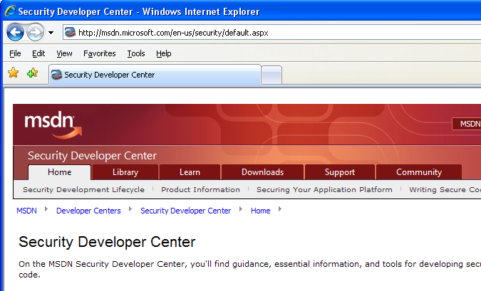

Microsoft Developer Network (MSDN) Security Developer Center
Official Web site: http://msdn.microsoft.com/security

Slide 26
Secure Development Blogs
The Microsoft Security Development Lifecycle (SDL) Blog: http://blogs.msdn.com/sdl
Michael Howard’s Blog: http://blogs.msdn.com/michael_howard

Slide 27
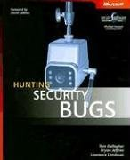
Microsoft Hunting Security Bugs
Hunting Security Bugs:
http://www.microsoft.com/mspress/books/8485.aspx

Slide 28
Additional SDL Training Content
Secure Design Principles
Secure Implementation Principles
Secure Verification Principles
SQL Injection Vulnerabilities
Cross-Site Scripting Vulnerabilities
Buffer Overflow Vulnerabilities

